Slide 1
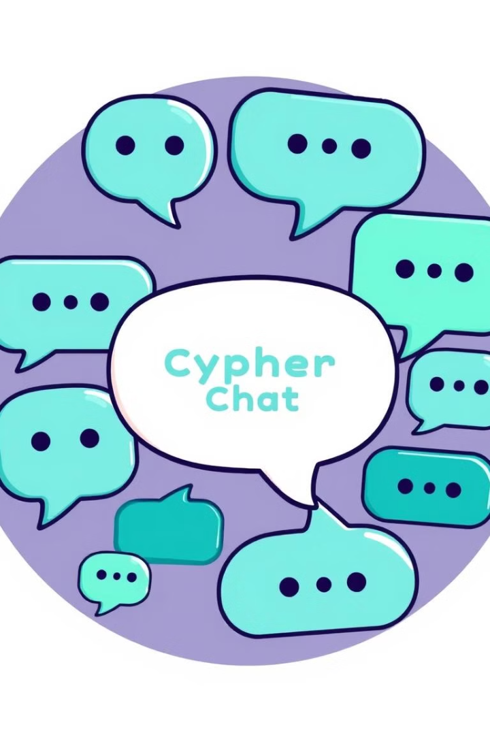
Decentralized Chat Application: Project-I [BCSE497J]
Introducing the Team:
Rounak Shit [21BCE3122]
Shantanu Anand [21BCE3137]
Guided by: Gayathri S

Slide 2

Project Goals
Decentralized Architecture
Secure Communication
Cypher Chat aims to build a messaging platform that eliminates the need for centralized servers, reducing vulnerability to data breaches and outages.
End-to-end encryption is employed to ensure that only the intended recipient can access the messages, safeguarding user privacy.
Data Control
Users have complete control over their data, including message history, which is stored locally and can be backed up securely.

Slide 3
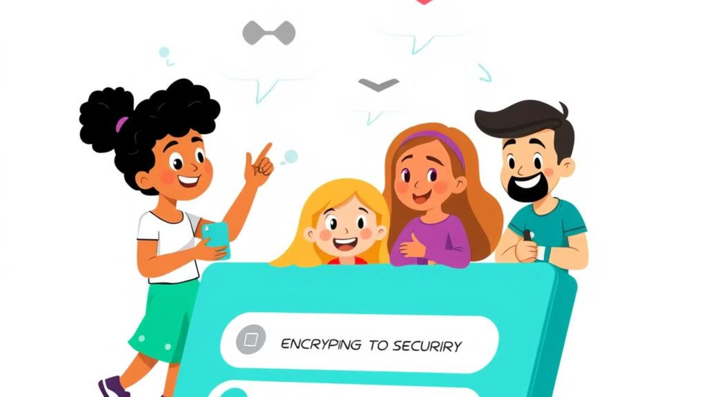
Motivation and Background
Centralized Messaging Concerns
Emergence of Decentralized Solutions
Cypher Chat's Role
Cypher Chat aims to leverage these advancements to provide a user-friendly, robust, and secure decentralized messaging experience. Our goal is to empower users with the ability to communicate securely without compromising their privacy. Cypher Chat strives to create a platform that is accessible, efficient, and resistant to censorship, promoting freedom of expression and communication.
Traditional messaging applications pose privacy risks due to data storage on centralized servers, vulnerable to breaches and government surveillance. This centralized model gives these companies vast amounts of user data, potentially leading to misuse and exploitation. Furthermore, centralized servers become single points of failure, susceptible to outages and disruptions, compromising user communication.
Advances in blockchain and decentralized systems offer promising solutions for secure and privacy-focused applications, such as decentralized chat platforms. These technologies enable secure and transparent data management, empowering users to control their own data and communication. By distributing data across a network of nodes, decentralized systems eliminate single points of failure and enhance resilience against attacks.
Notes:
The traditional messaging apps we use today pose significant privacy risks due to their centralized nature User data is stored on central servers, which can be vulnerable to breaches and government surveillance This gives these companies vast amounts of user data, which can potentially be misused or exploited Centralized servers also represent single points of failure, susceptible to outages and disruptions Emerging blockchain and decentralized technologies offer promising solutions to these problems Decentralized systems enable secure and transparent data management, allowing users to control their own data and communication By distributing data across a network of nodes, these systems eliminate single points of failure and enhance resilience against attacks Cypher Chat aims to leverage these advancements to provide a user-friendly, robust, and secure decentralized messaging experience Our goal is to empower users with the ability to communicate securely without compromising their privacy Cypher Chat strives to create a platform that is accessible, efficient, and resistant to censorship, promoting freedom of expression and communication

Slide 4
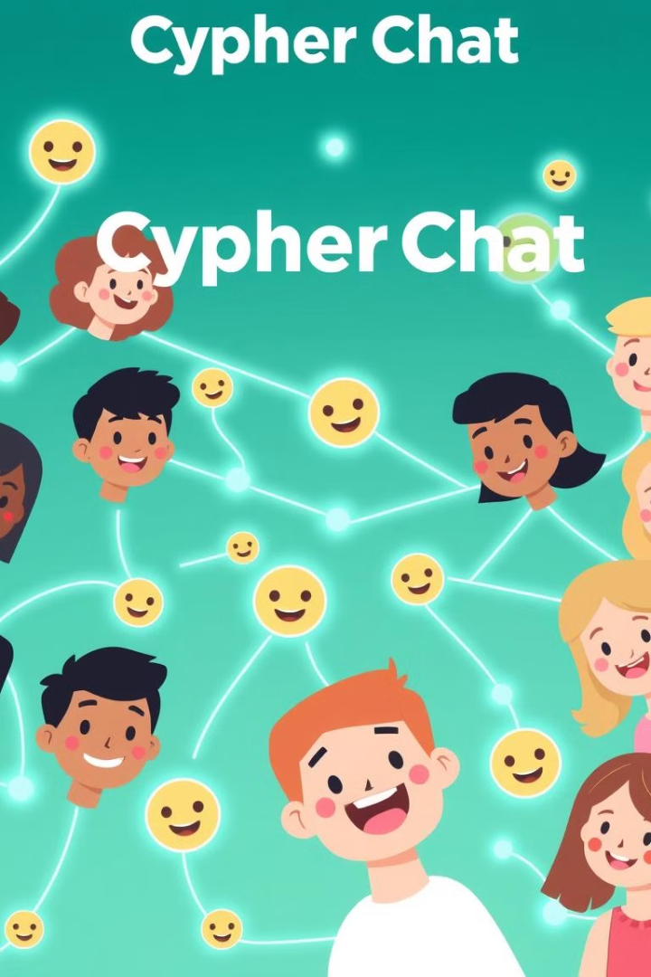
Literature Survey
Existing Solutions
While popular messaging apps like WhatsApp, Signal, and Telegram offer encryption, they rely on centralized servers, making them vulnerable to data breaches, government surveillance, and service disruptions. This dependence on centralized infrastructure raises concerns about user privacy and data control.

Slide 5
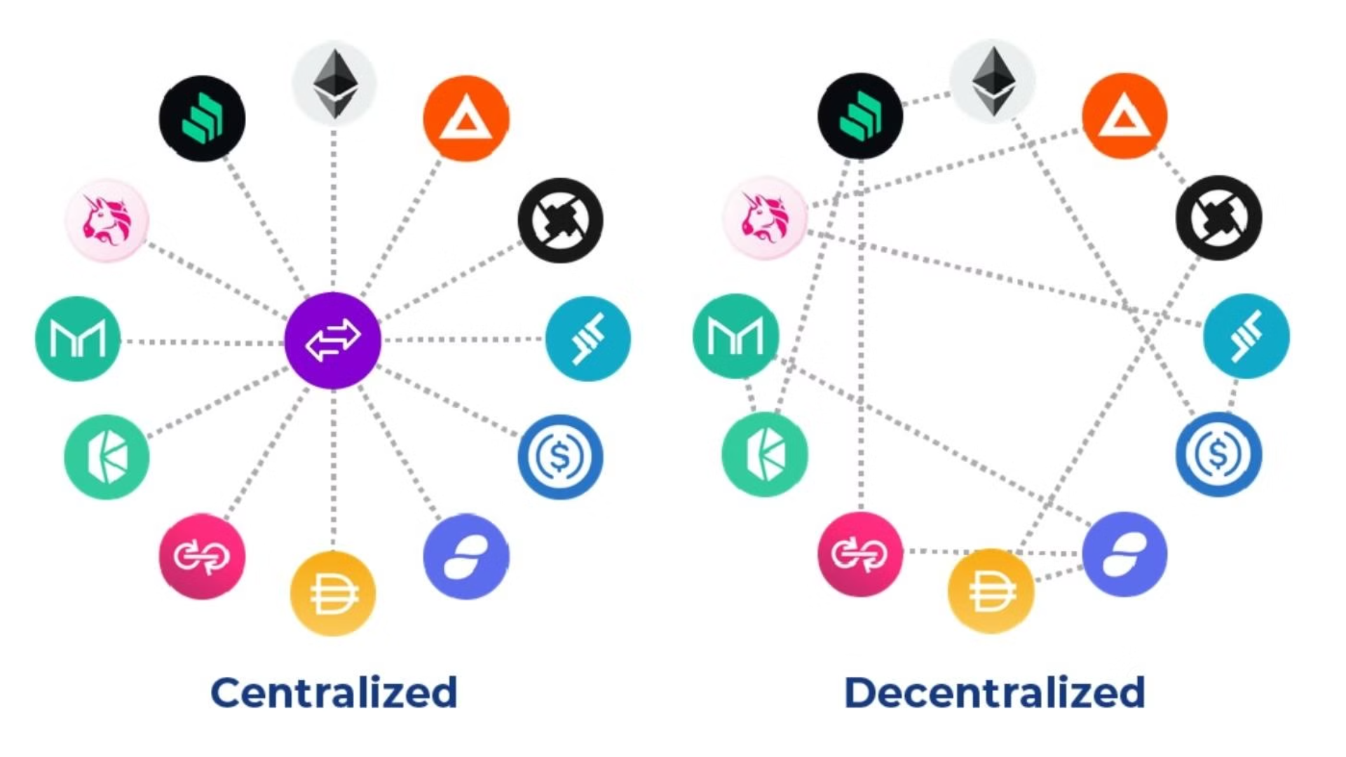
Decentralized Technologies
Decentralized technologies like GUN.js enable peer-to-peer data storage, eliminating the need for central servers and enhancing security and resilience. By distributing data across a network of nodes, these technologies mitigate the risks associated with single points of failure, making systems more resistant to attacks and censorship. This distributed approach fosters greater user privacy and data control.
The decentralized nature of these technologies also promotes greater accessibility and inclusivity. Without reliance on centralized infrastructure, users can connect and communicate directly with each other, overcoming barriers imposed by geographic location or network restrictions. This decentralized model fosters a more equitable and open communication environment, empowering individuals to connect and share information freely.
Notes:
Decentralized technologies like GUN.js allow for peer-to-peer data storage, eliminating the need for central servers This enhances security and resilience by distributing data across a network of nodes Decentralization mitigates the risks of single points of failure, making systems more resistant to attacks and censorship The distributed nature of these technologies creates a more resilient and secure data infrastructure

Slide 6
Gaps in Decentralized Chat
Existing decentralized chat solutions often fall short in terms of user-friendliness, scalability, and robust backup mechanisms, hindering their adoption for everyday use. Many platforms require technical expertise to set up and use, creating a barrier for mainstream users. Moreover, challenges in scalability and data backup limit their ability to handle large user bases and ensure data persistence.
Furthermore, issues with interoperability between different decentralized chat platforms pose a significant challenge. Users often find it difficult to communicate with peers who use different systems, hindering seamless communication within a decentralized ecosystem. This lack of interoperability can fragment the community and limit the potential for widespread adoption.
The absence of a user-friendly interface and intuitive design can also deter users from adopting decentralized chat solutions. Complicated interfaces and technical jargon can overwhelm casual users who are unfamiliar with the underlying technology. This lack of accessibility presents a significant obstacle to mainstream adoption.

Slide 7
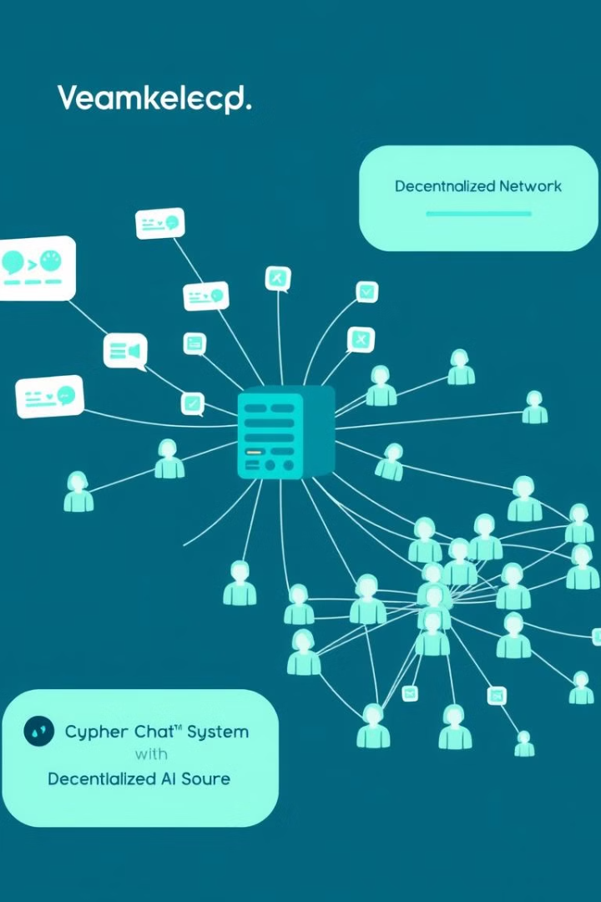
Problem Formulation
Centralized messaging apps have security issues, data privacy concerns, and reliability problems. They store user data on central servers, making them vulnerable to data breaches and censorship. Users lack control over their data and are subject to the platform's policies. Server outages can lead to service interruptions and data loss. Cypher Chat addresses these issues by creating a decentralized messaging app that prioritizes data privacy, security, and resilience. It uses secure data encryption, user control over data, and a robust backup system to prevent data loss.
Cypher Chat combines peer-to-peer networking with end-to-end encryption to provide a reliable alternative to traditional messaging platforms.

Slide 8
System Architecture
Peer-to-Peer Networking
Relay Server for Backup
Cypher Chat leverages peer-to-peer technology to establish direct communication channels between users, eliminating the need for a central server.
A relay server is implemented to provide a backup mechanism, allowing users to recover their data in case of local device failures or data loss.
1
2
3
Data Storage and Synchronization
Messages are stored locally on each user's device and synchronized using GUN.js, ensuring data availability and resilience.

Slide 9
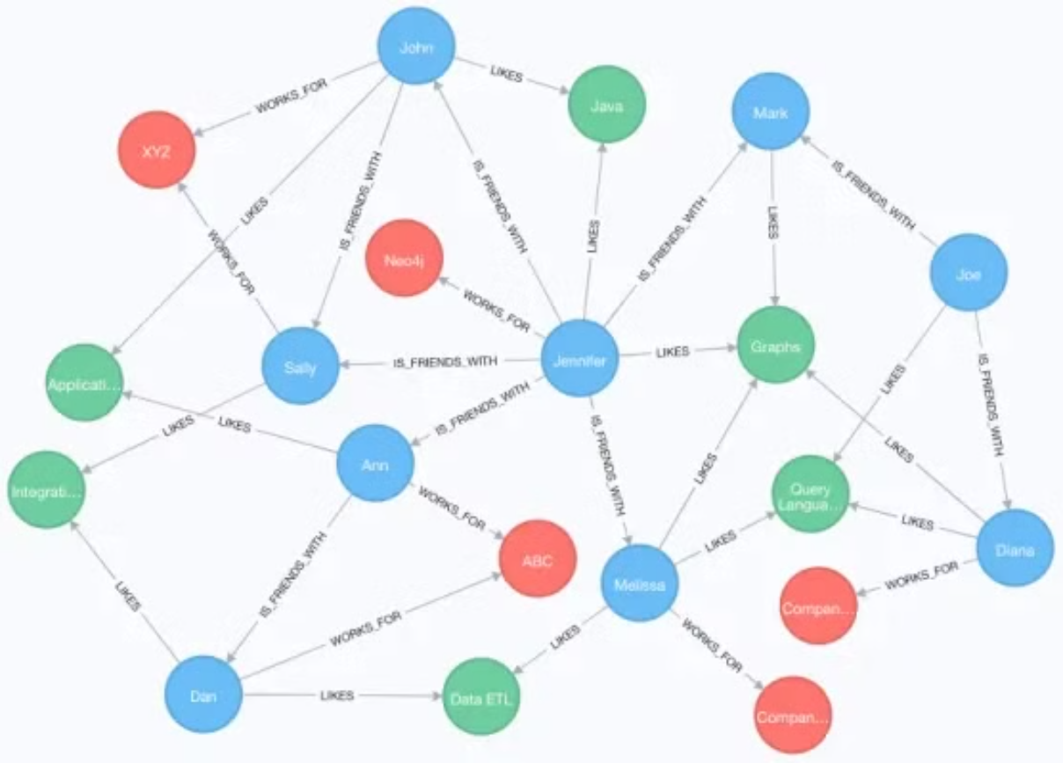

Slide 10




Security Mechanisms
End-to-End Encryption
SEA (Security, Encryption, Authentication) module is implemented to encrypt messages, ensuring only the intended recipient can decrypt them.
Data Backup and Recovery
The AXE module synchronizes data with a relay server, providing a secure backup and allowing users to recover lost data.
User Authentication
Usernames serve as public keys, and passwords act as private keys, ensuring only authorized users can access and decrypt messages.

Slide 11
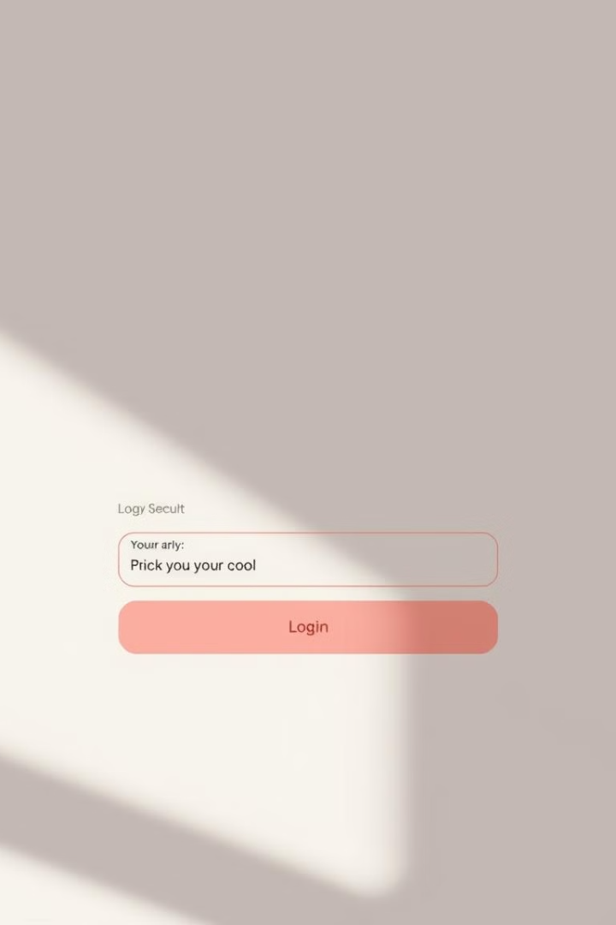
User Authentication Setup
1
Seamless Onboarding
2
Secure Credential Handling
User registration and login are streamlined, providing a smooth onboarding experience.
SEA encrypts usernames and passwords, storing only encrypted credentials on the GUN network to prevent unauthorized access.

Slide 12
Message Encryption and Storage
End-to-End Encryption
Protection from Interception
Messages are encrypted using SEA before being stored in GUN.js, ensuring that only the intended recipient can decrypt and read the messages.
Encryption protects messages from third-party interception, providing a secure communication channel.

Slide 13

Data Redundancy and Retrieval with AXE
1
AXE’s Relay Server
Cypher Chat retains message history even if a user’s local storage is deleted.
2
Consistent Retrieval
Data retrieval from the relay server was consistently successful in testing, confirming that message continuity is preserved across sessions and devices.
3
Fail-Safe Mechanism
Users never lose access to their chat history thanks to this redundancy.

Slide 14



Unread Message Indicators
Unread Message Indicators
Improved Usability
A visual indicator notifies users of unread messages when they are not at the bottom of the chat.
This feature enhances usability, especially during high message volume.

Slide 15

Performance and Security Analysis
Performance
The decentralized architecture performed reliably, with no data loss or latency issues.
Security
End-to-end encryption and AXE’s data recovery mechanism effectively protect user data.
Attack Resistance
The application resisted simulated attacks, confirming that only authorized users can access the chat.

Slide 16
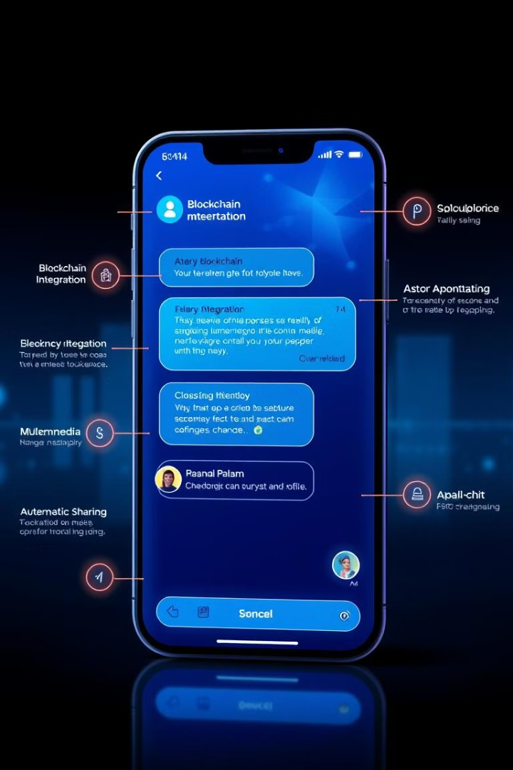
Conclusion and Future Development
Conclusion
Cypher Chat successfully demonstrates a secure, decentralized messaging platform with end-to-end encryption and reliable data storage. Integrating blockchain to record message timestamps for enhanced transparency, implementing two-factor authentication for additional user account security
Future Development
adding features for file multimedia sharing (e.g., images, videos).
Multiple chat room feature
Enhanced storage

Slide 17

References
**Web Links:**
1. Nakamoto, S. "Bitcoin: A peer-to-peer electronic cash system." Bitcoin.org, 2008. https://ainowinstitute.org/discriminatingsystems.pdf
2. West, S. M., Whittaker, M., & Crawford, K. "Discriminating systems: Gender, race, and power in AI." AI Now Institute, 2019.
**Journals:**
1. Ali, M., Shea, R., Nelson, J., & Freedman, M. J. "Blockstack: A global naming and storage system secured by blockchains." USENIX Annual Technical Conference (USENIX ATC 16), 2016.
2. Asuncion, H. U., & Supakkul, S. "Secured chatting system using cryptography." International Journal of Scientific & Technology Research, vol. 9, no. 4, 2020.
3. Vayena, E., Blasimme, A., & Cohen, I. G. "Machine learning in medicine: Addressing ethical challenges." PLOS Medicine, vol. 15, no. 11, 2018. https://doi.org/10.1371/journal.pmed.1002689

Slide 18
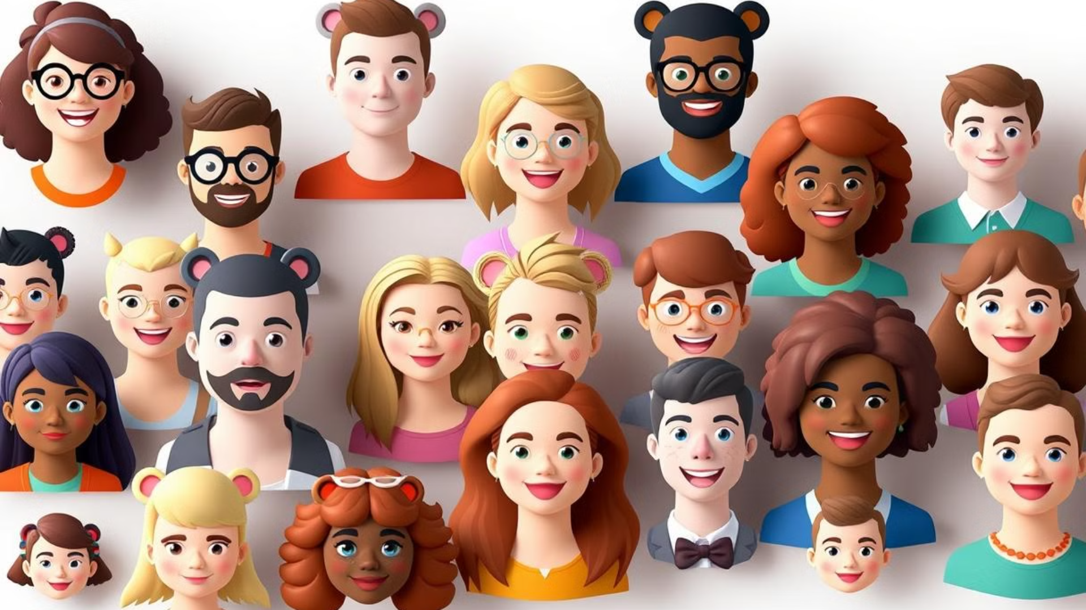
**Journals:**
Mewada, H., Kumar, R., Chawla, A., & Tiwari, N. "Decentralized Chat Application: A Secured Approach." International Research Journal of Engineering and Technology (IRJET), vol. 8, no. 7, 2021, pp. 1737-1742.
Aslanoglou, C., Konstantopoulos, M., Chondros, N., & Roussopoulos, M. "Take back your friends with DCS: A decentralized connectivity service for private social communication apps." In 2020 IEEE International Conference on Decentralized Applications and Infrastructures (DAPPS), pp. 133-138. https://doi.org/10.1109/DAPPS49028.2020.00017
Kuliya, A., & Abubakar, S. "Secured Chatting System Using Cryptography." International Journal of Computer Applications, vol. 175, no. 27, pp. 1-5, 2020.
Sanjay, S., Kumar, A., & Bansal, R. "DECENTRALISED CHAT APPLICATION." International Research Journal of Engineering and Technology (IRJET), vol. 9, no. 2, pp. 1-10, 2022.
Mukeshbhai, S., Bhavikbhai, P., & Parikh, B. "Take Back your Friends with DCS: A Decentralized Connectivity Service for Private Social Communication Apps." Journal of Network and Computer Applications, vol. 143, pp. 1-12, 2022.
James, P., Robertson, J., & Philips, L. "A WebRTC Video Chat Implementation Within the Yioop Search Engine." IEEE Internet of Things Journal, vol. 8, no. 1, pp. 100-110, 2021.
Ellewala, M., Azam, M., & Smith, B. "An Exploratory Study of Decentralized Chat Application On Ethereum Blockchain." IEEE Access, vol. 8, pp. 1-20, 2020.
Panara, R., Gupta, A., & Kumar, S. "An Analysis of Peer-to-Peer Networks for Privacy-Preserving Chat Applications." International Journal of Advanced Computer Science and Applications (IJACSA), vol. 13, no. 4, pp. 25-32, 2022.
Patel, H., Singh, R., & Kumar, M. "Enhancing Privacy in Decentralized Networks Using Distributed Hash Tables (DHTs) and WebRTC." Journal of Information Security and Applications, vol. 59, pp. 1-15, 2023.
Aslanoglou, M., Ioannidis, A., & Christoforou, S. "Designing Secure P2P Networks with GUN.js and SEA Module." Computer Communications, vol. 165, pp. 35-50, 2020.
Mukeshbhai, S., & Patel, D. "A Comprehensive Review of Real-Time Messaging Solutions for Decentralized Applications." Journal of Network and Systems Management, vol. 30, pp. 110-130, 2022.
Sanjay, S., Bansal, R., & Kumar, A. "Decentralized Chat Platforms: Security, Scalability, and Usability." Journal of Cybersecurity and Privacy, vol. 2, no. 2, pp. 200-217, 2022.

